Slide 1
Inductive Logic Programming: The Problem Specification
Given:
  Examples: first-order atoms or definite clauses, each labeled positive or negative.
  Background knowledge: in the form of a definite clause theory.
  Language bias: constraints on the form of interesting new clauses.

Slide 2
ILP Specification (Continued)
Find:
  A hypothesis h that meets the language constraints and that, when conjoined with B, entails (implies) all of the positive examples but none of the negative examples.
To handle real-world issues such as noise, we often relax the requirements, so that h need only entail significantly more positive examples than negative examples.

Slide 3
A Common Approach
Use a greedy covering algorithm.
  Repeat while some positive examples remain uncovered (not entailed):
    Find a good clause (one that covers as many positive examples as possible but no/few negatives).
    Add that clause to the current theory, and remove the positive examples that it covers.
ILP algorithms use this approach but vary in their method for finding a good clause.

Slide 4
A Difficulty
Problem: It is undecidable in general whether one definite clause implies another, or whether a definite clause together with a logical theory implies a ground atom.
Approach: Use subsumption rather than implication.

Slide 5
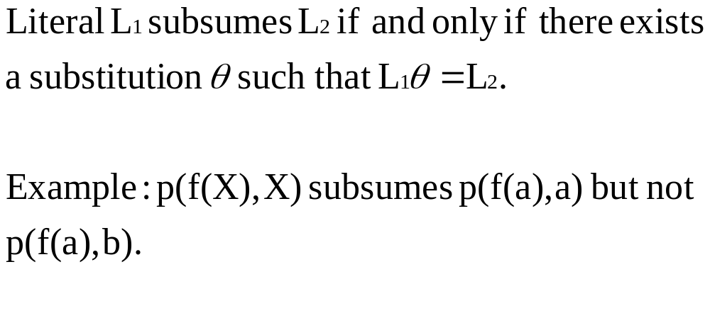
Subsumption for Literals

Slide 6
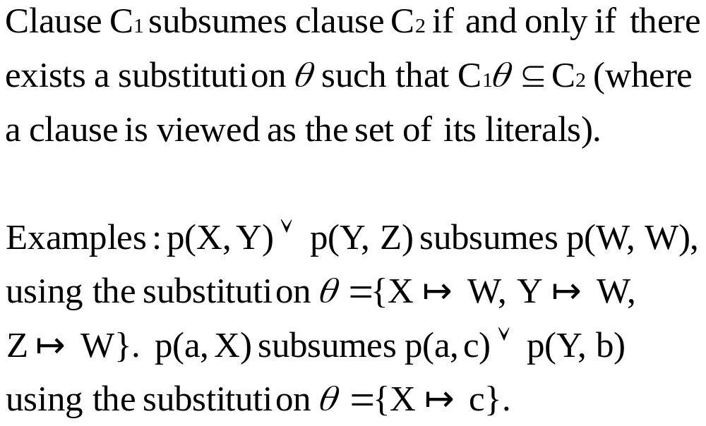
Subsumption for Clauses

Slide 7
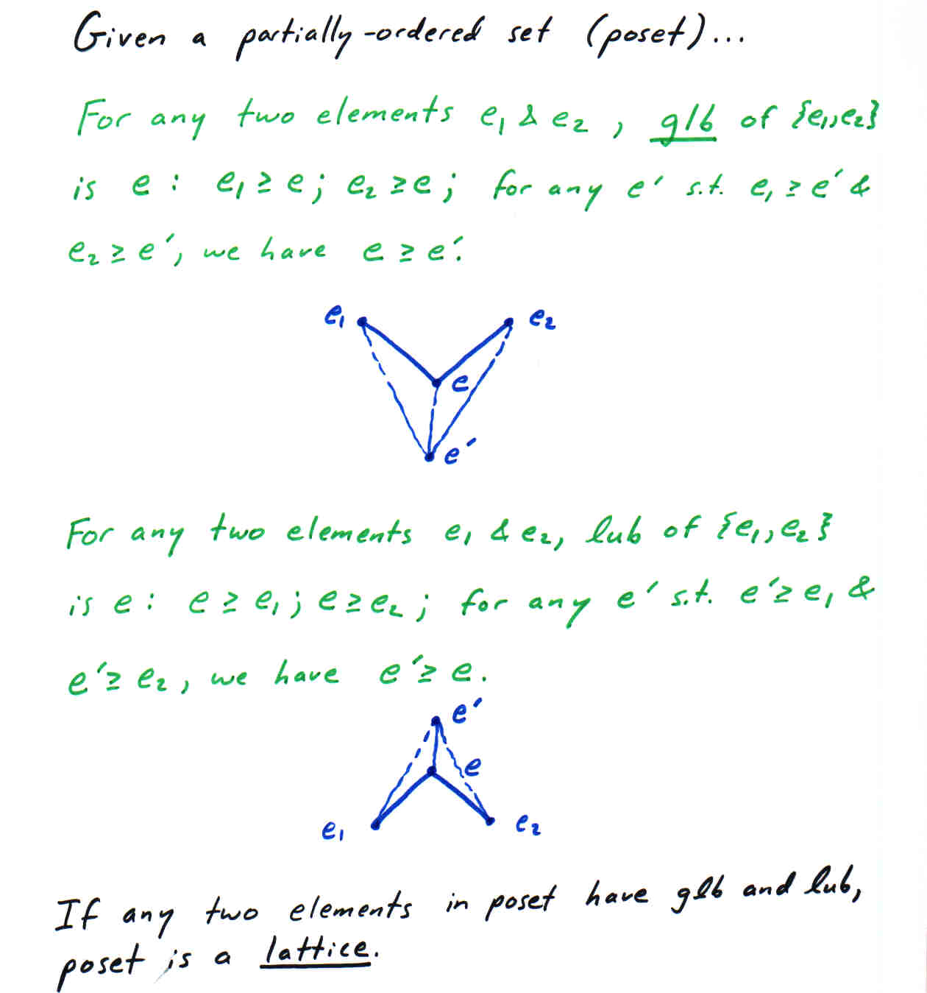

Slide 8
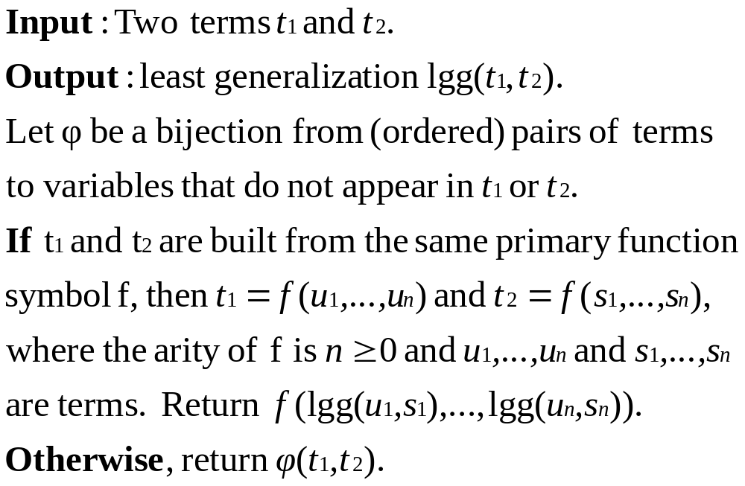
Least Generalization of Terms

Slide 9
Least Generalization of Terms (Continued)
Examples:
  lgg(a,a) = a
  lgg(X,a) = Y
  lgg(f(a,b),g(a)) = Z
  lgg(f(a,g(a)),f(b,g(b))) = f(X,g(X))
lgg(t₁,t₂,t₃) = lgg(t₁,lgg(t₂,t₃)) = lgg(lgg(t₁,t₂),t₃): justifies finding the lgg of a set of terms using the pairwise algorithm.

Slide 10
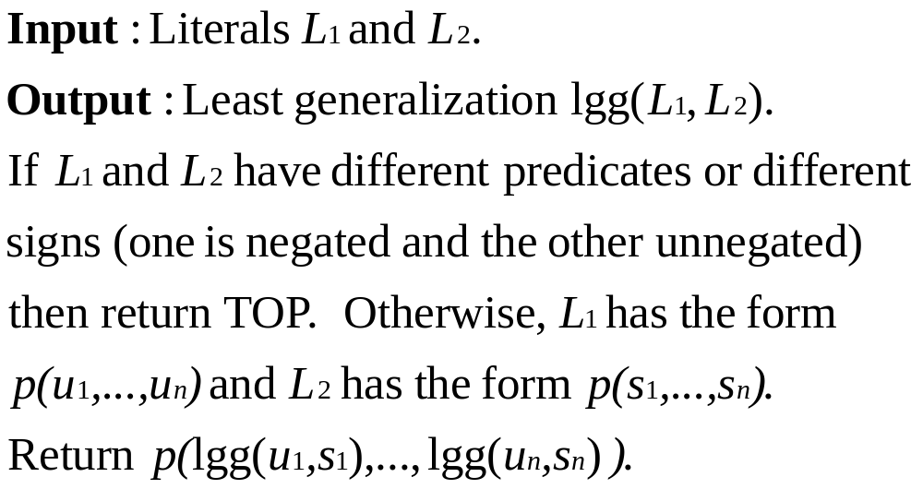
Least Generalization of Literals

Slide 11
Lattice of Literals
Consider the following partially ordered set.
Each member of the set is an equivalence class of literals, equivalent under variance.
One member of the set is greater than another if and only if one member of the first set subsumes one member of the second (can be shown equivalent to saying: if and only if every member of the first set subsumes every member of the second).

Slide 12
Lattice of Literals (Continued)
For simplicity, we now will identify each equivalence class with one (arbitrary) representative literal.
Add elements TOP and BOTTOM to this set, where TOP is greater than every literal, and every literal is greater than BOTTOM.
Every pair of literals has a least upper bound, which is their lgg.

Slide 13
Lattice of Literals (Continued)
Every pair of literals has a greatest lower bound, which is their greatest common instance (the result of applying their most general unifier to either literal, or BOTTOM if no most general unifier exists.)
Therefore, this partially ordered set satisfies the definition of a lattice.

Slide 14
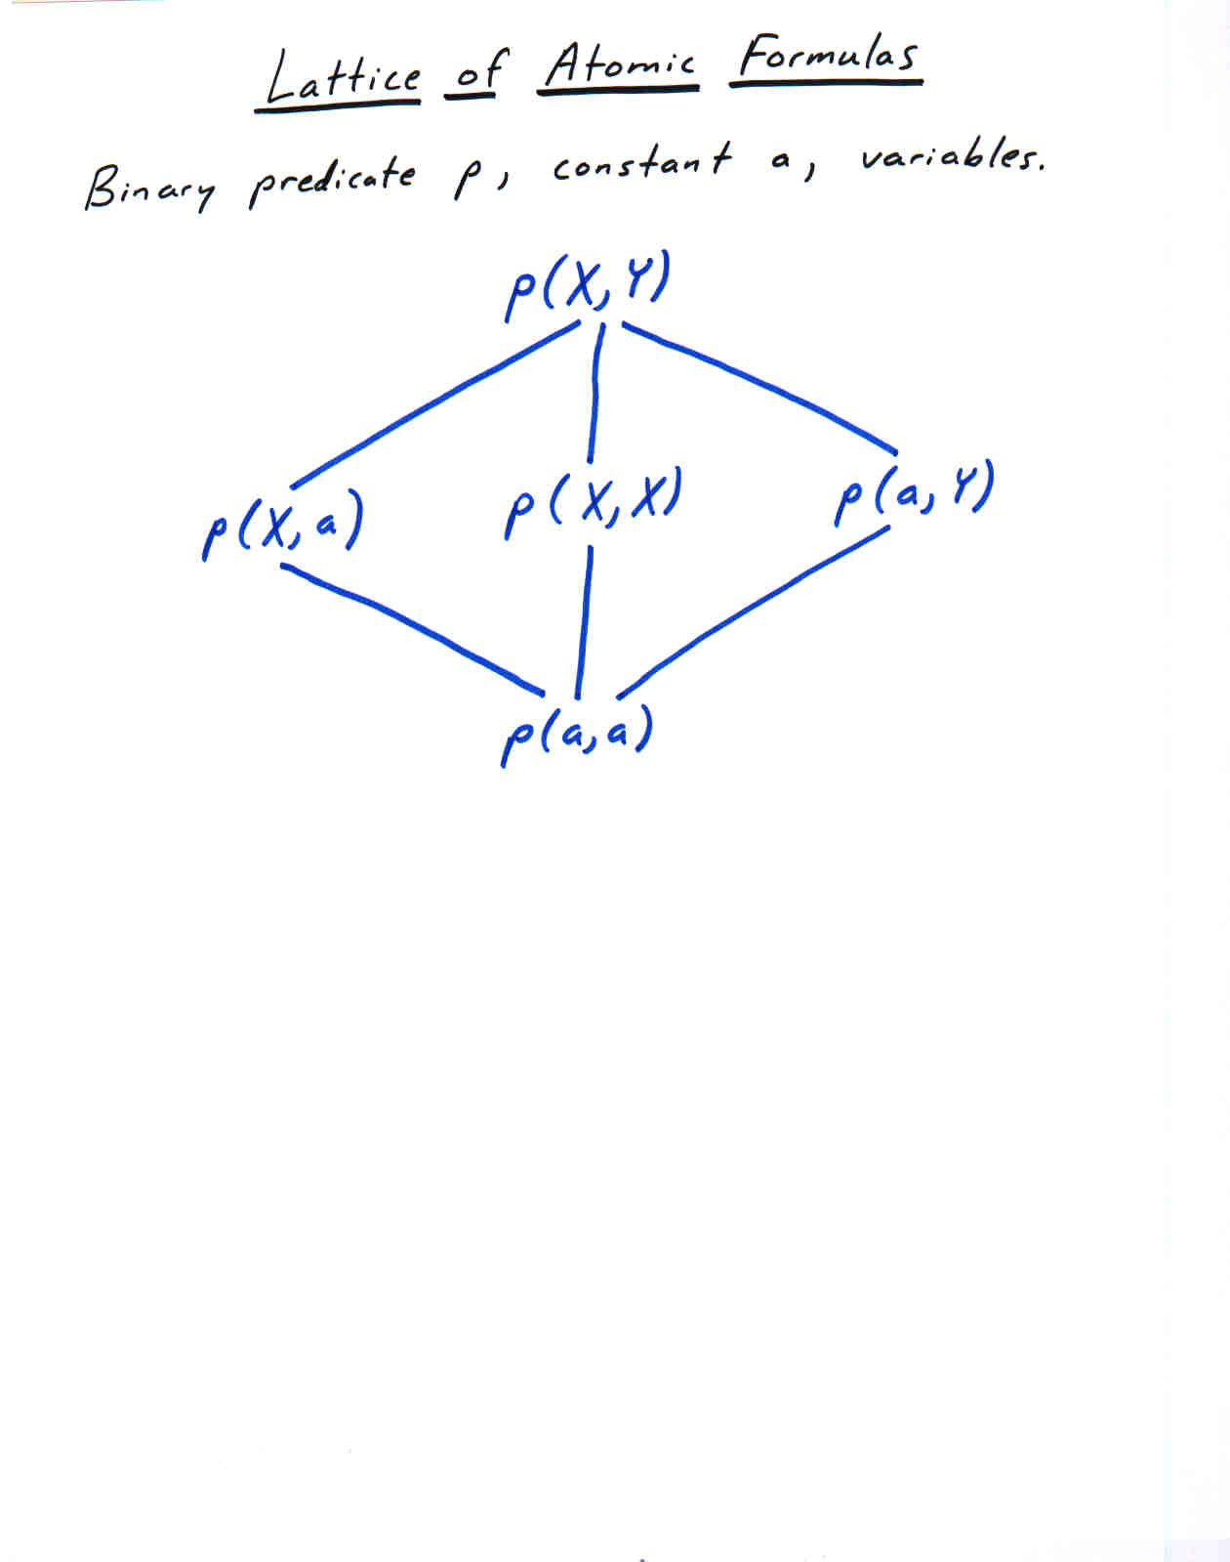

Slide 15
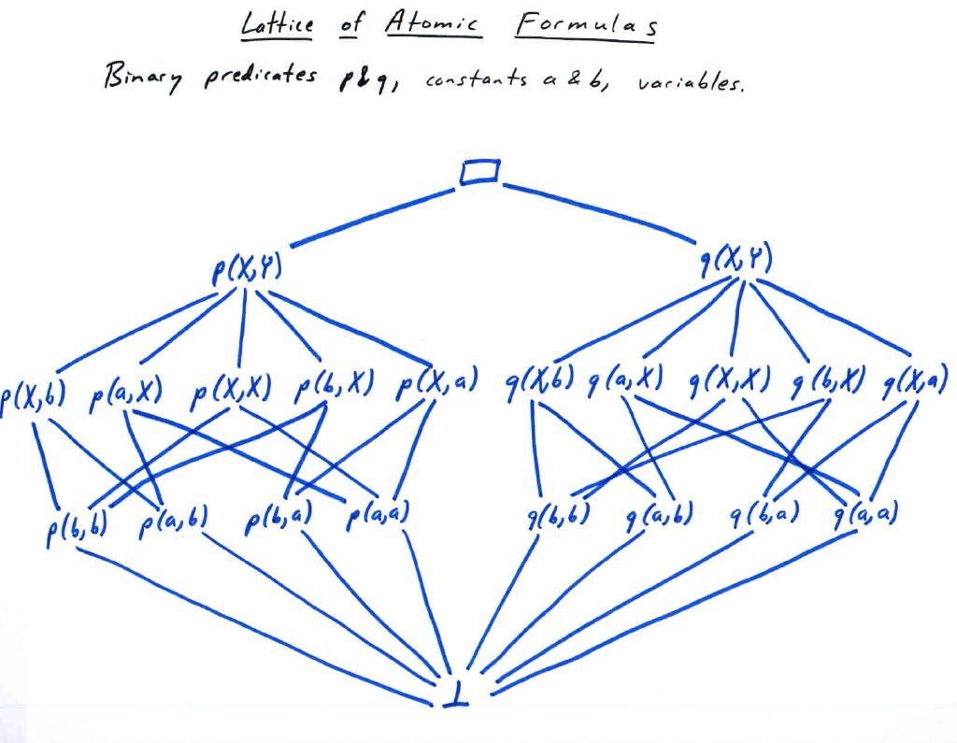

Slide 16
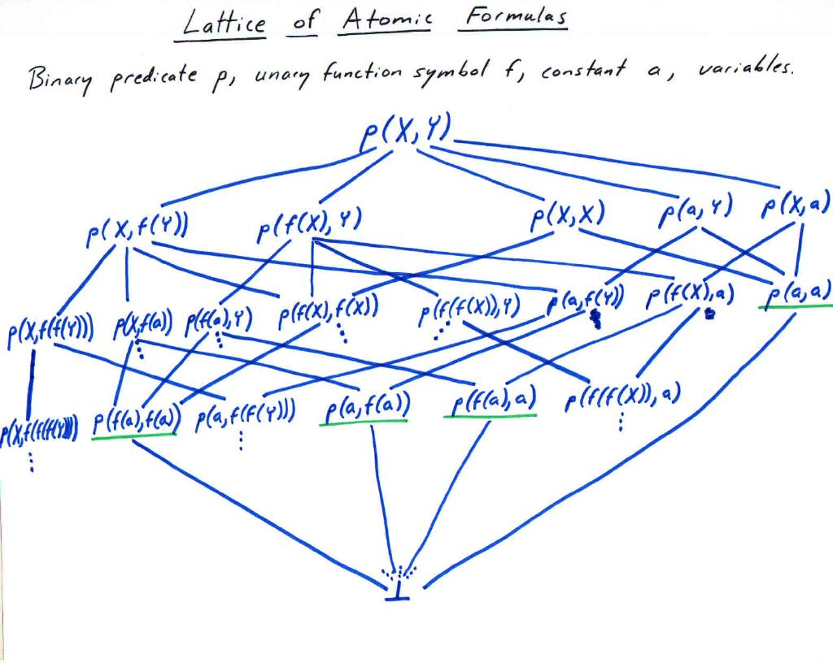

Slide 17
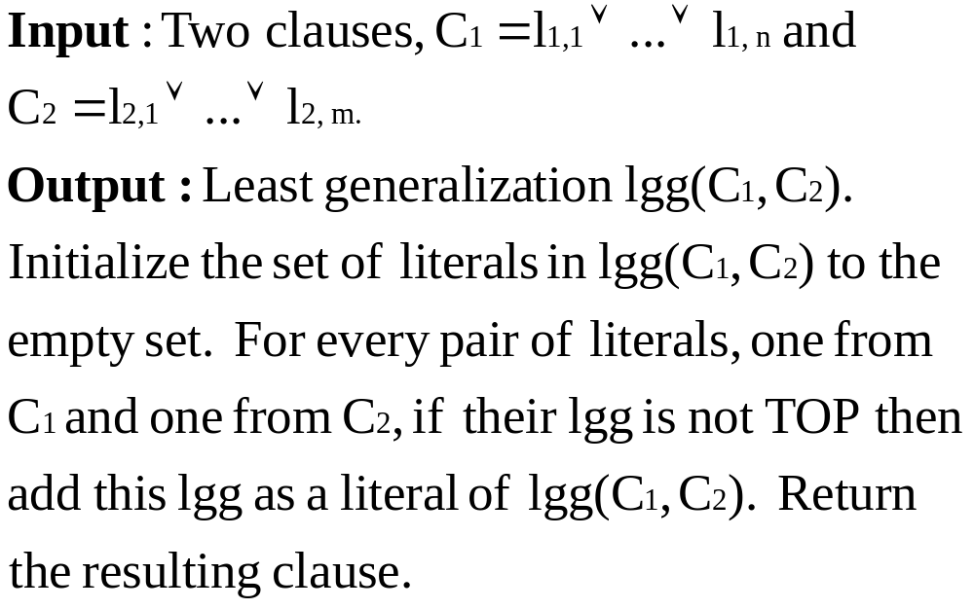
Least Generalization of Clauses

Slide 18
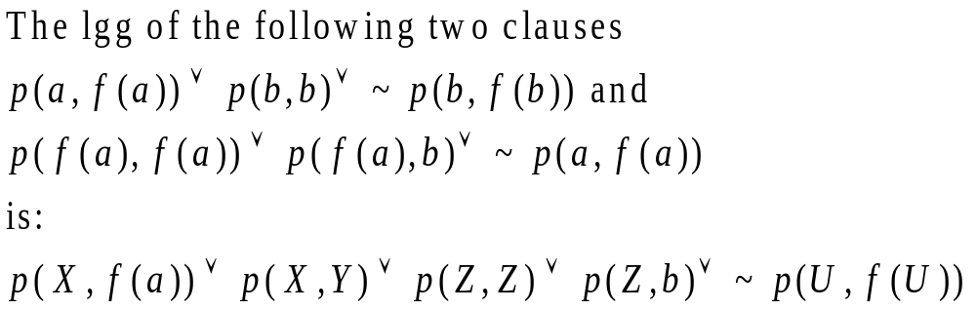
Example

Slide 19
Lattice of Clauses
We can construct a lattice of clauses in a manner analogous to our construction of literals.
Again, the ordering is subsumption; again we group clauses into variants; and again we add TOP and BOTTOM elements.
Again the least upper bound is the lgg, but the greatest lower bound is just the union (clause containing all literals from each).

Slide 20
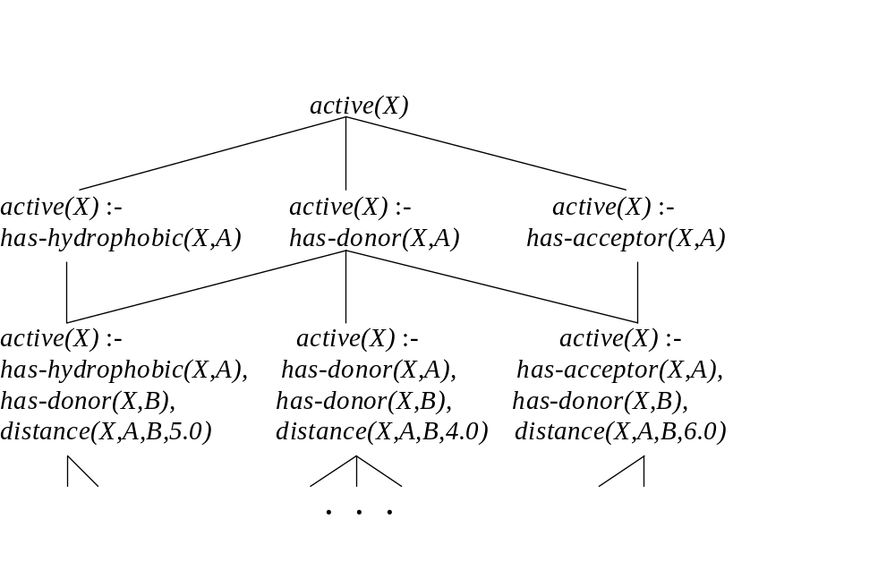
Lattice of Clauses for the Given Hypothesis Language

Slide 21
Incorporating Background Knowledge: Saturation
Recall that we wish to find a hypothesis clause h that together with the background knowledge B will entail the positive examples but not the negative examples.
Consider an arbitrary positive example e. Our hypothesis h together with B should entail e: B∧h ⊨ e. We can also write this as h ⊨ B → e.

Slide 22
Saturation (Continued)
If e is an atom (atomic formula), and we only use atoms from B, then B → e is a definite clause.
We call B → e the saturation of e with respect to B.

Slide 23
Saturation (Continued)
Recall that we approximate entailment by subsumption.
Our hypothesis h must be in that part of the lattice of clauses above (subsuming) B → e.

Slide 24
Alternative Derivation of Saturation
From B∧h ⊨ e by contraposition: B ∧{¬e} ⊨ ¬ h.
Again by contraposition: h ⊨ ¬ (B ∧ ¬e)
So by DeMorgan’s Law: h ⊨ ¬ B ∨ e
If e is an atom (atomic formula), and we only use atoms from B, then ¬ B ∨ e is a definite clause.

Slide 25
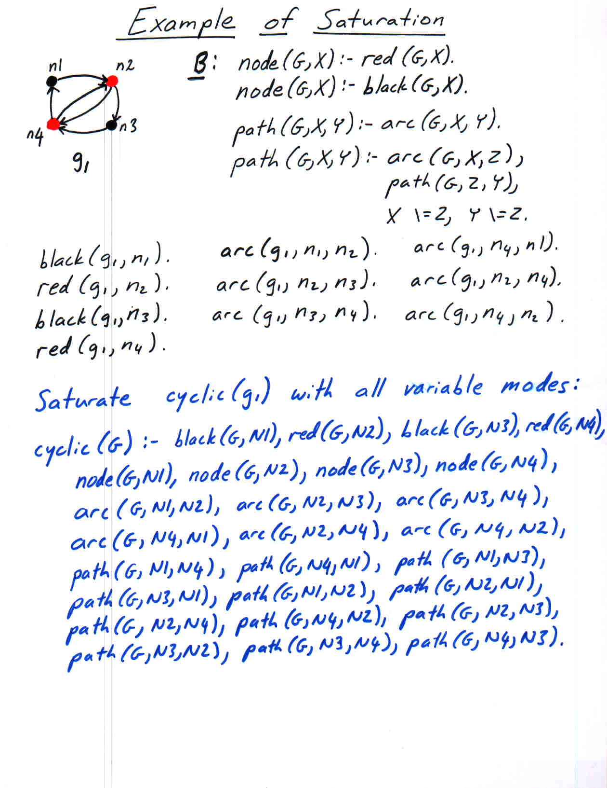

Slide 26
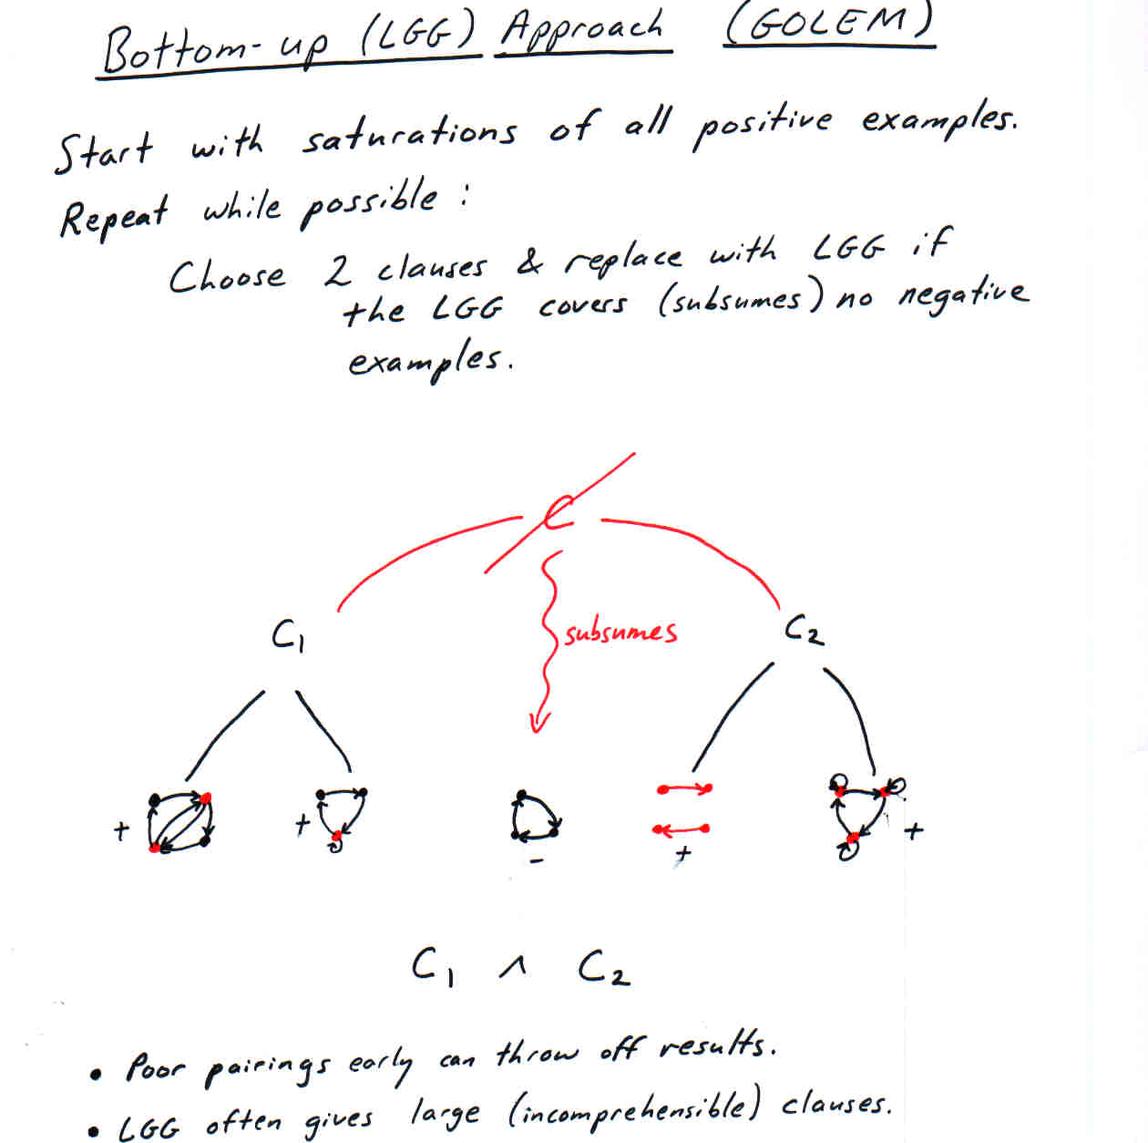

Slide 27
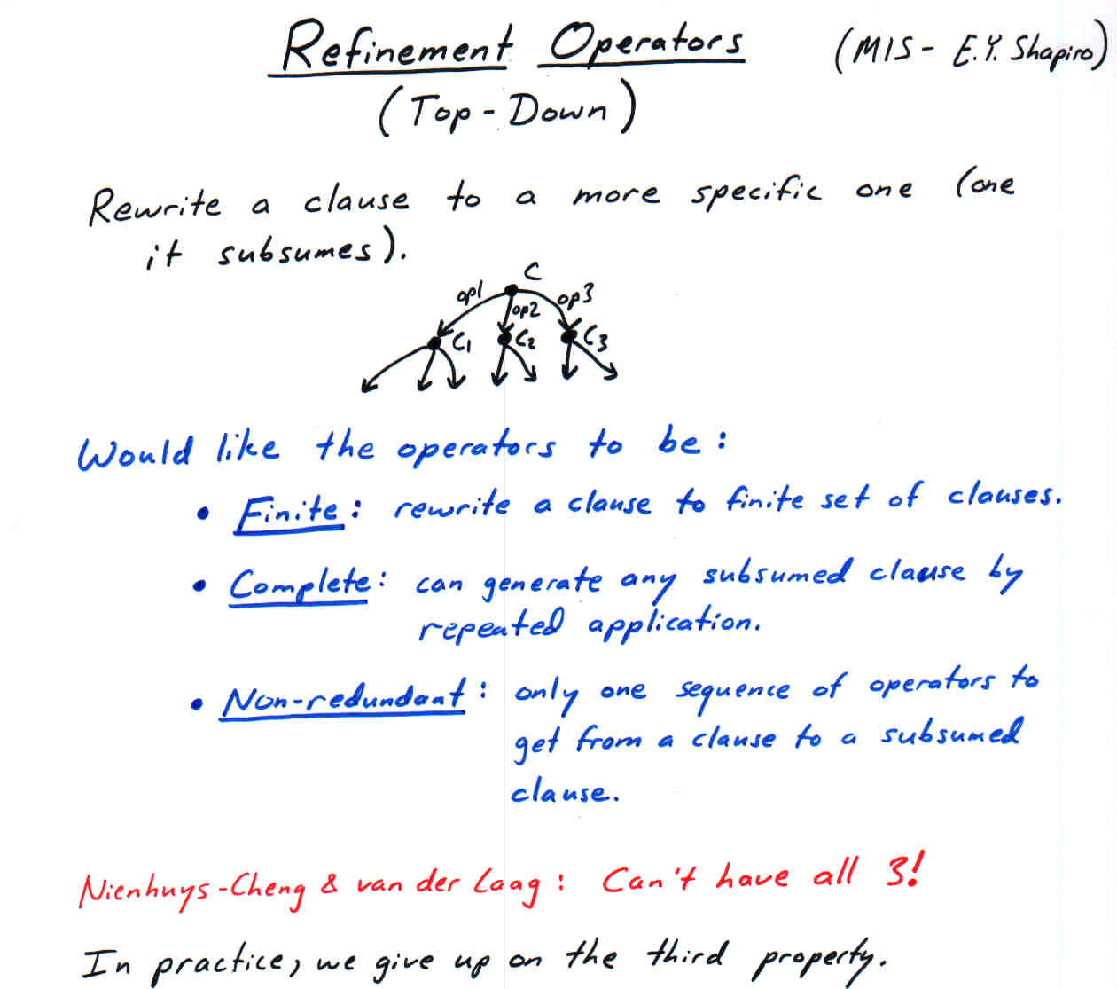

Slide 28
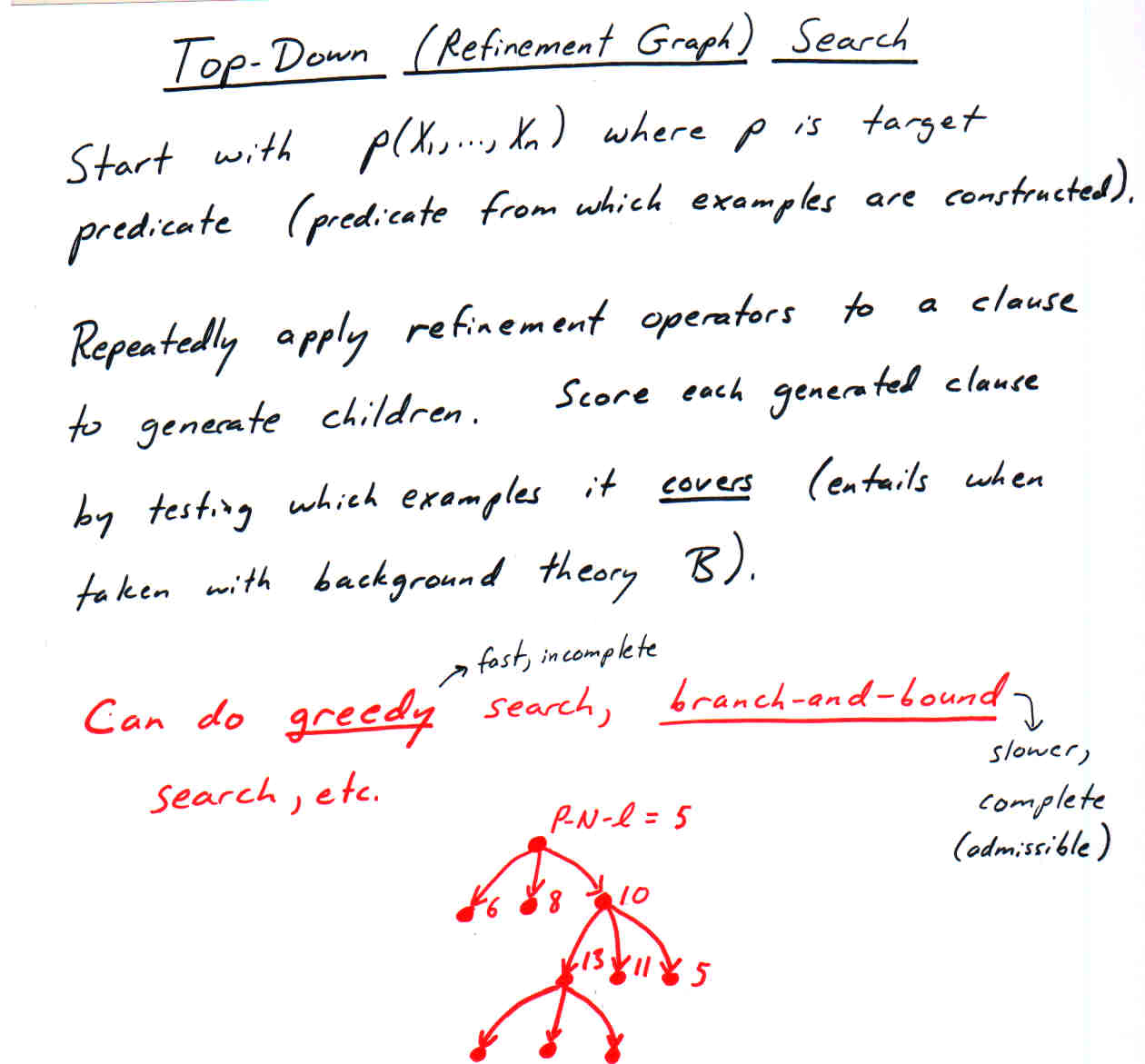

Slide 29
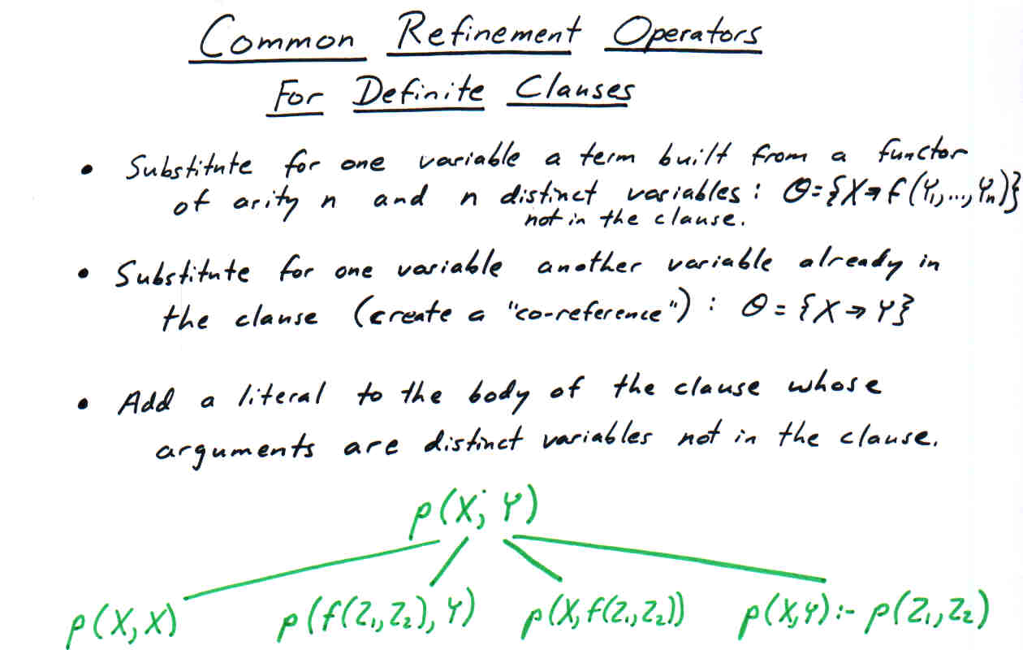

Slide 30
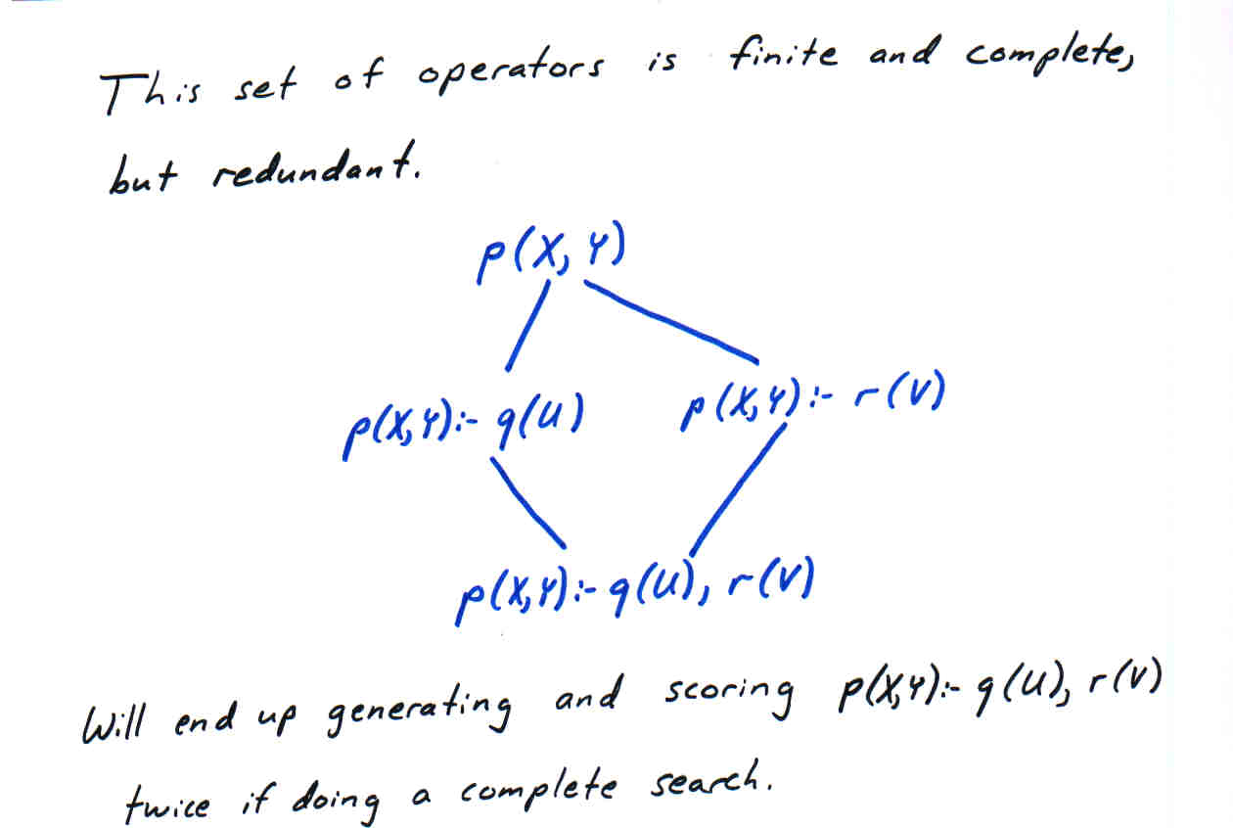

Slide 31
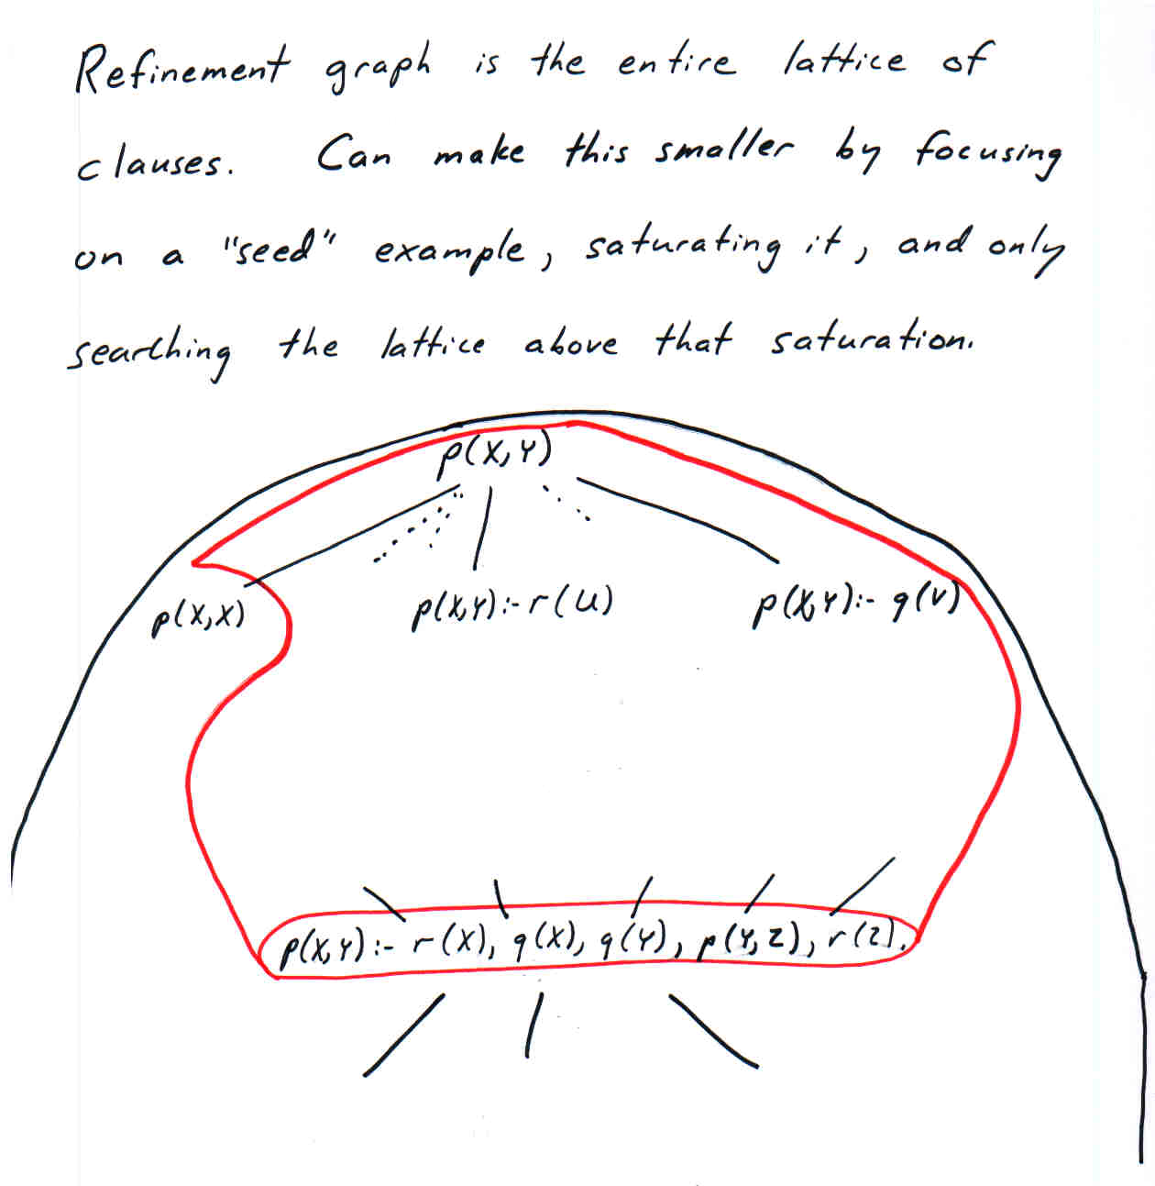

Slide 32
Overview of Some ILP Algorithms
GOLEM (bottom-up): saturates every positive example and then repeatedly takes lggs as long as the result does not cover a negative example.
PROGOL, ALEPH (top-down): saturates first uncovered positive example, and then performs top-down admissible search of the lattice above this saturated example.

Slide 33
Algorithms (Continued)
FOIL (top-down): performs greedy top-down search of the lattice of clauses (does not use saturation).
LINUS/DINUS: strictly limit the representation language, convert the task to propositional logic, and use a propositional (single-table) learning algorithm.

